Slide 1
Title of Your Invention
First Name, Last Initial
Age
State or Country

Slide 2
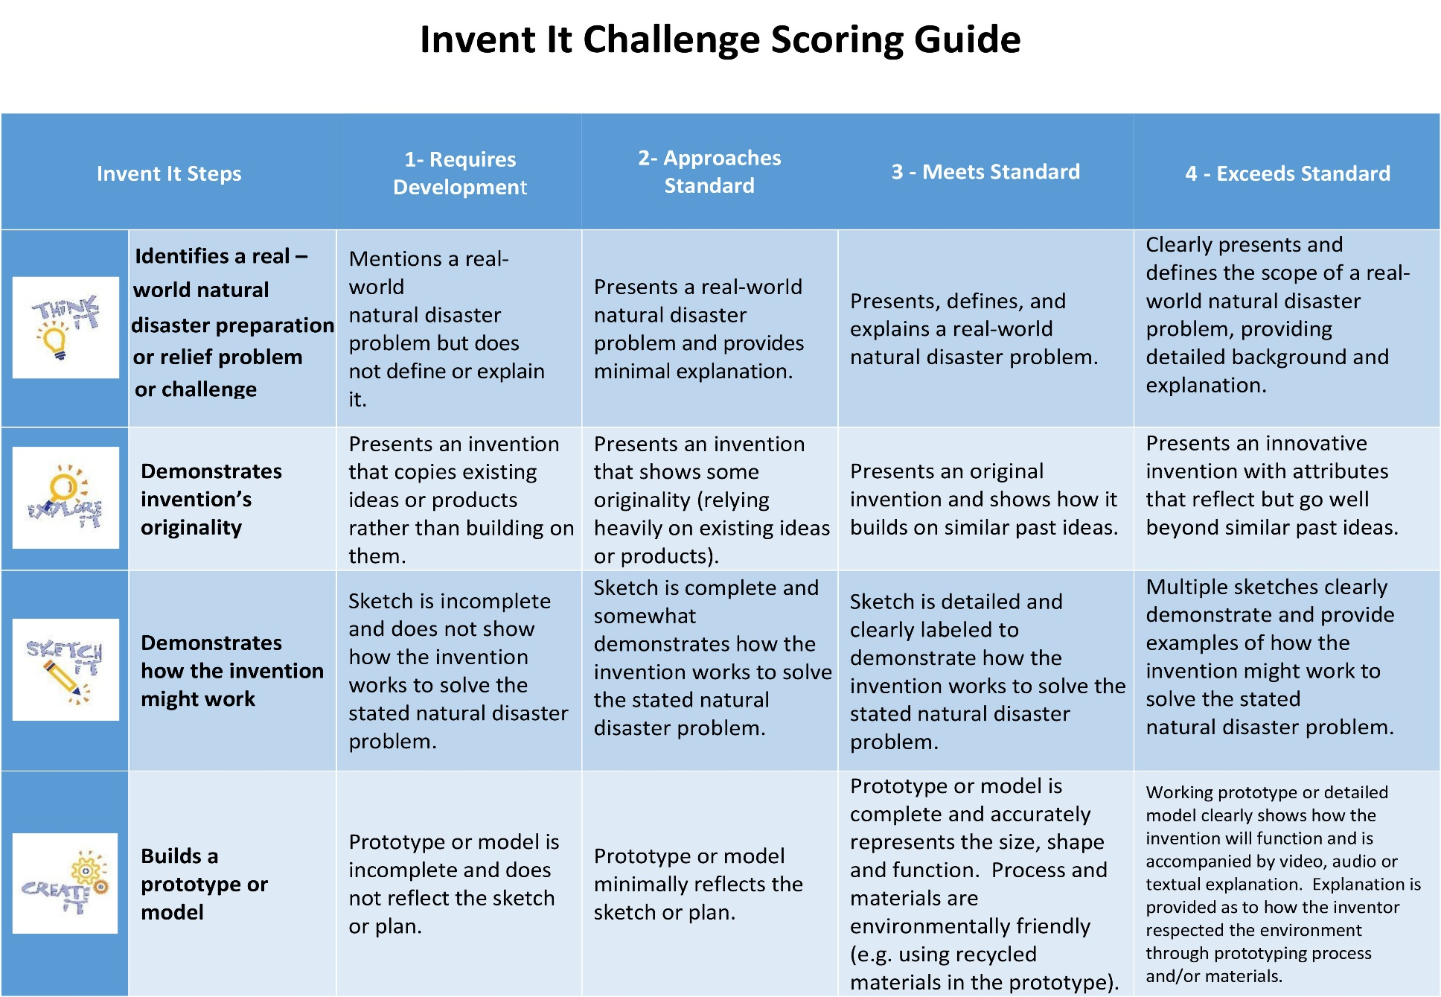
Things to think about as you complete your submission
Please delete this slide before you finalize and submit your invention presentation!

Slide 3
Things to think about as you complete your submission
Please delete this slide before you finalize and submit your invention presentation!

Slide 4
Things to think about as you complete your submission
Take time to make your presentation impressive.
Use diagrams, video, voice, and photos.
You may include multiple slides for each step
of the invention process.
All PowerPoint presentations will be converted into MP4 video format for viewing purposes. Please double check your presentation so that all of your work appears on the screen.
Embed your video and audio files into your presentation.
If you are using a version of PowerPoint before 2013 and are embedding video and audio files, save your final presentation as an MP4 so that the videos and audio remain in your presentation.
Avoid hyperlinks. To direct viewers to an online element, include the complete URL/Web Address (Example: https://challenges.epals.com/inventit)
Avoid including information in the PowerPoint NOTES sections as it will not be reviewed by judges. Find a way to integrate this information onto the slides instead.
Use your first name only - no last names!
Please delete this slide before you finalize and submit your invention presentation!

Slide 5
Describe a real-world natural disaster preparation and relief problem or challenge and your invention idea to solve it.

Slide 6
Investigate how other inventors have tried to solve or address the problem/challenge.

Slide 7
Draw pictures and diagrams to show your invention and how it might work.

Slide 8
Build your prototype or model of your invention.

Slide 9
Test your invention.

Slide 10
Improve your invention.

Slide 11
Pitch your invention to a target audience, clearly explaining the benefits to people affected by natural disasters.

