Slide 1
The Invention Process: Step 1
Think it
Identify a Problem or Need
Notes:
The Invention Process: Step One

Slide 2
Step 1: Think It
1
2
3
4
5
6
7
Notes:
In this lesson, you are going to learn how to complete the first step in the invention process, THINK IT, by identifying a problem that you would like to solve and beginning to imagine your solution!

Slide 3
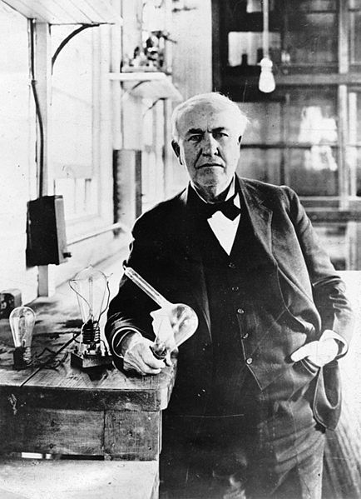
Inventions Solve Problems
Thomas Edison
Notes:
You know that inventions are used to solve problems. Famous inventors like
Edison solved the problem of needing a longer lasting light with a light bulb…

Slide 4
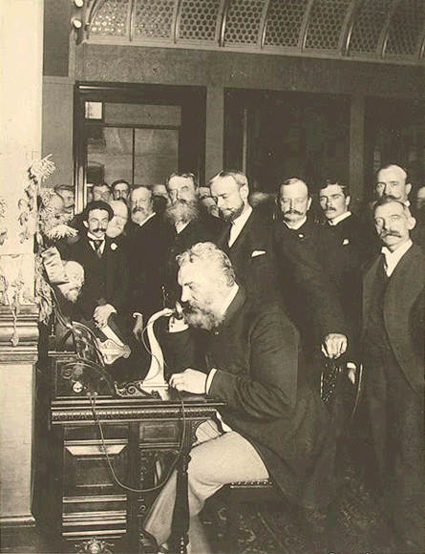
Inventions Solve Problems
Alexander Graham Bell
Thomas Edison
Notes:
…and Alexander Graham Bell solved the problem of communicating over distance with the telephone.

Slide 5
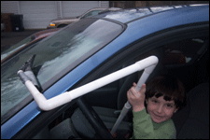
Turbo Skraper
Sam – Pennsylvania, USA
Inventions Solve Problems
Notes:
In past ePals Invent It Contests, students like you have solved many different kinds of problems. For example, seven-year old Sam tackled the issue of getting cold while scraping your car windshield by creating a scraper that can be used from inside the car. (play sound byte)

Slide 6
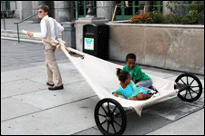
Refugee Travois: Salvation on Wheels
Chase – North Carolina, USA
Inventions Solve Problems
Notes:
Chase, a 13-year old from North Carolina, invented a refugee travois to help a single parent transport multiple children easily to safety. (play sound byte)

Slide 7
Personal
School
Community
Global
Identify a Problem
Notes:
To identify a problem you might want to solve as an inventor, start by brainstorming. Grab your pencil or computer and make a list of problems:

Slide 8
Personal
School
Community
Global
Can’t find things in a purse
Marlie S.
- Mississippi, USA
Unorganized sports
equipment
Pierre S., Léa S., Clément S., Laurie V., Sarah G., Adrien B., Romain J., Justin M., Théo L., Mathis D., Mathilde S. - France
Identify a Problem
Notes:
First, Think About Your Own Life – what problems do you have at your home, school or community that an invention might help? Can you identify a bigger, global problem that affects many people in the world? What current products frustrate you?

Slide 9
Personal
School
Community
Global
Can’t find things in a purse
Marlie S.
- Mississippi, USA
Desks too short for tall
students
Laila E., Angela A., Mitzi C. - California, USA
Unorganized sports
equipment
Pierre S., Léa S., Clément S., Laurie V., Sarah G., Adrien B., Romain J., Justin M., Théo L., Mathis D., Mathilde S. - France
Trash around community
Emily B., Abby T. - Florida, USA
driving wrong way on highway exit causing accidents
Charlotte J. - California, USA
Identify a Problem
Notes:
Then, ask friends, family and teachers what problems they’d like to solve in their lives, your school or community. Is there something your friends often complain about? As you listen to their responses, think about how solving their problems could help others improve their lives.

Slide 10
Personal
School
Community
Global
Can’t find things in a purse
Marlie S.
- Mississippi, USA
children eating unhealthy foods
Nithin S. - India
Desks too short for tall
students
Laila E., Angela A., Mitzi C. - California, USA
Cars using too much gasoline
Damian J.
- New Jersey, USA
Unorganized sports
equipment
Pierre S., Léa S., Clément S., Laurie V., Sarah G., Adrien B., Romain J., Justin M., Théo L., Mathis D., Mathilde S. - France
Trash around community
Emily B., Abby T. - Florida, USA
driving wrong way on highway exit causing accidents
Charlotte J. - California, USA
Medicines not available in remote villages
Trisha
- India
Identify a Problem
Notes:
Finally, read the newspaper or watch the news to find out about bigger, global problems you could tackle.

Slide 11
Personal
School
Community
Global
Problem
Problem
Problem
Problem
Problem
Problem
Problem
Problem
Choose a problem to solve
Notes:
Now that you have a list, you have a big decision to make! Which problem is possible for you to solve with a new invention? Which problem fascinates you? Do you have an idea already?

Slide 12
Personal
School
Community
Global
Problem
Problem
Problem
Problem
Problem
Problem
Problem
Problem
Choose a problem to solve
Notes:
Using the process of elimination, cross off the ones that least interest you.
Cross of the ones that don’t seem solvable by an invention.

Slide 13
Personal
School
Community
Global
Problem
Problem
Problem
Problem
Problem
Problem
Problem
Problem
Choose a problem to solve
Notes:
Make your final decision by selecting the problem that really sparks your curiosity and gets you excited about inventing!
Remember, identifying your problem and solution is the bedrock of your invention! Choose wisely!

Slide 14
Pencils are made of wood
Save trees with improved pencil
Get Started
Notes:
Get started right now by listing possible problems on the first page in your inventor’s notebook. You may wish to start a section titled Think It!

Slide 15
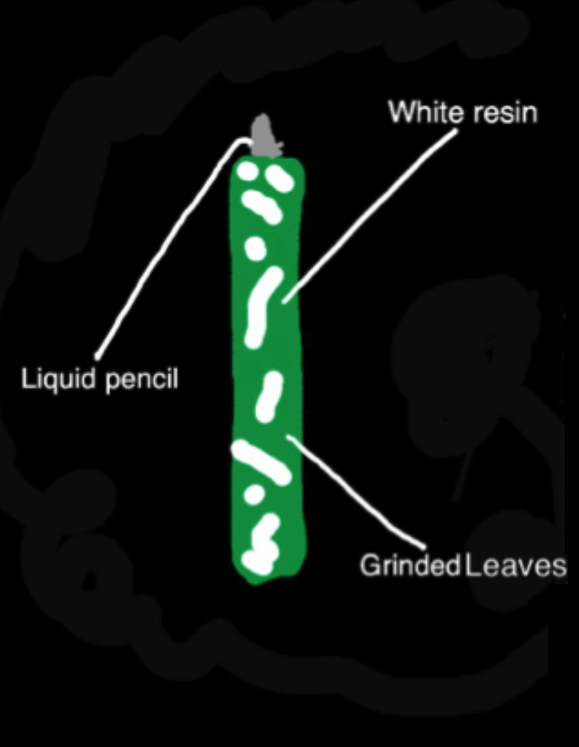
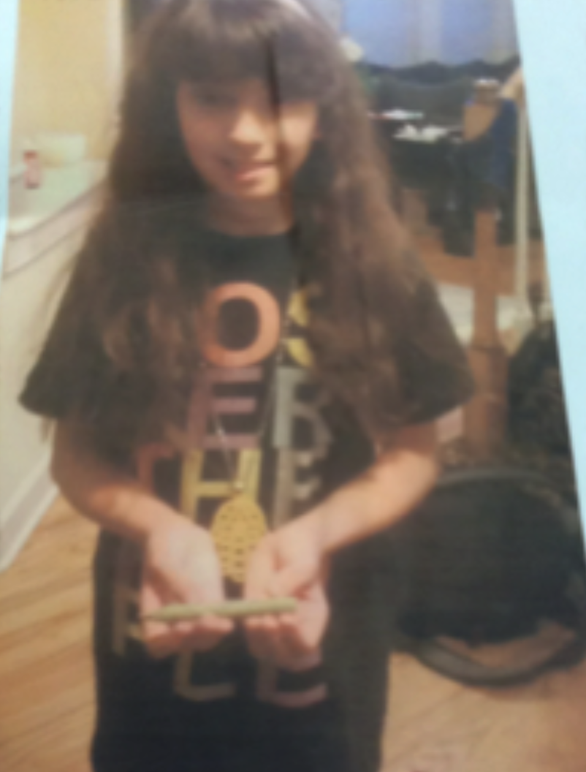
Pencils are made of wood
Save trees with improved pencil
Get Started
Notes:
Then use your notebook to capture all your notes and sketches throughout the steps of your invention process.
Your notebook will help you when you prepare your entry for submission.

Slide 16
That’s the 1st Step in the invention process.
Can’t wait to see your problem
Notes:
Now you know how to complete step one of the invention process: THINK IT…..by generating a list of problems and choosing one that sparks your interest as an inventor!

