Slide 1
Introduction to
The Invention Process
Notes:
Let’s learn about the Invention Process!

Slide 2
How do inventors invent?
Albert Einstein
Notes:
Thinking about becoming an inventor? A good place to start is by answering the question “How do inventors invent?” Do they just have a bright idea one day and a completed invention the next? Inventors tell us that’s NOT usually how it works! Inventing is a process.

Slide 3
The 7 Key Steps of the Inventing Process
1
2
3
4
5
6
7
Notes:
Let’s take a look at the seven key steps of the inventing process, as identified by the Smithsonian’s Lemelson Center.

Slide 4
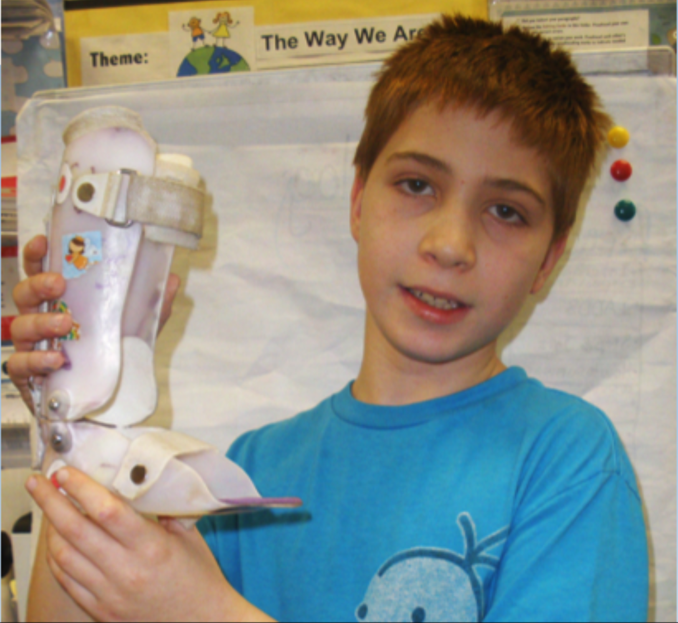
Identify a problem
or need.
Imagine you’re a little boy or girl, maybe five years old, and you have a leg disability.
You can’t run or keep up with your friends. Every day you have to put on uncomfortable leg braces to walk. Tons of people all over the world have a problem just like this.
My baby sister Zizi has leg disabilities. That’s why I’m making Z-lectric Braces. Z-lectric Braces help you walk, run and swim better. They also have balance sensors and are comfortable and stylish.
Charlie - USA
Imagine you have a leg disability…
Notes:
Think It. Inventors first must identify a problem or need. Having a problem to solve is the bedrock of your invention process. The problem could address a personal, school, community or global need. No problem is too big or small, too simple or too complex to think about. Charlie found his idea at home, with his baby sister.

Slide 5
2. Conduct research.
Have you ever worked with
someone who has shaking hands?
Yes. I have worked with students as well as elderly citizens.
What problems did this cause?
People had trouble cooking, feeding themselves, and writing, They also had problems with buttons, zippers, and snaps.
How did you help people with these problems?
I used adaptive tools such as weighted utensils, big handles, plates with suction, and weighted pencils. Wrist weights also help.
I know some people like my grandfather have trouble with shaking hands. I interviewed an
Occupational Therapist
to see what she thought.
Hannah - USA
Look to see what solutions have been developed before to solve the problem you’ve identified, and what other inventors are doing now to address the same problem.
Notes:
Explore It. Next, inventors must conduct research. In this step, inventors look to see what solutions have been developed before to solve the problem they’ve identified, and what other inventors are doing now to address the same problem. Serious inventors also talks to experts in the field and asks questions. Once the research is complete, they think about how a new invention can improve on the earlier ones and provide an even better solution. In this case, Hannah though up an idea called the Sand Sleeve, which would weigh down a person’s shaky wrist.

Slide 6
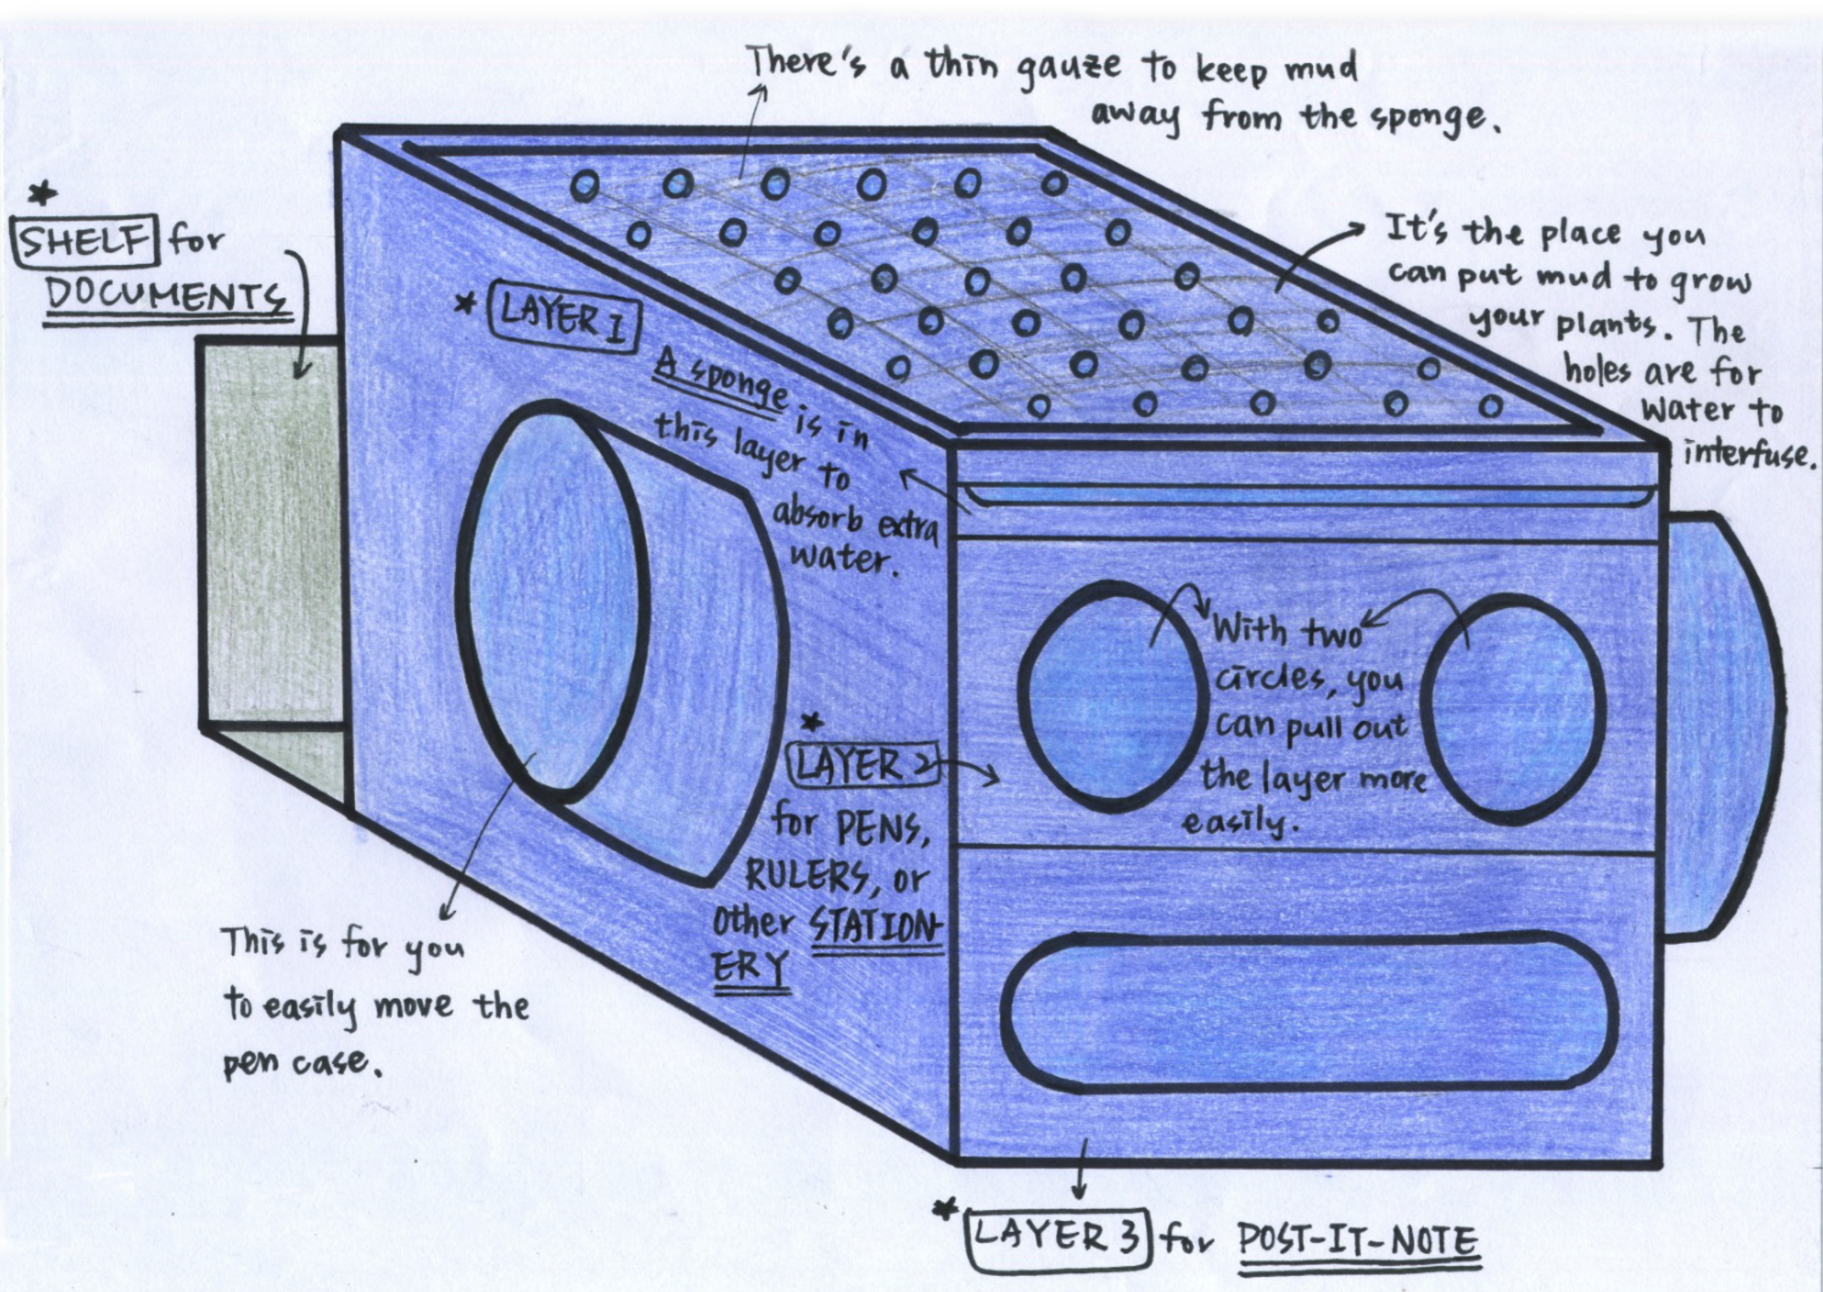
3. Draw your invention idea.
Yuan-Shan - Taiwan
Notes:
Sketch It. Inventors frequently sketch their ideas. Drawing can help you visualize what your invention will look like and how it will work.

Slide 7
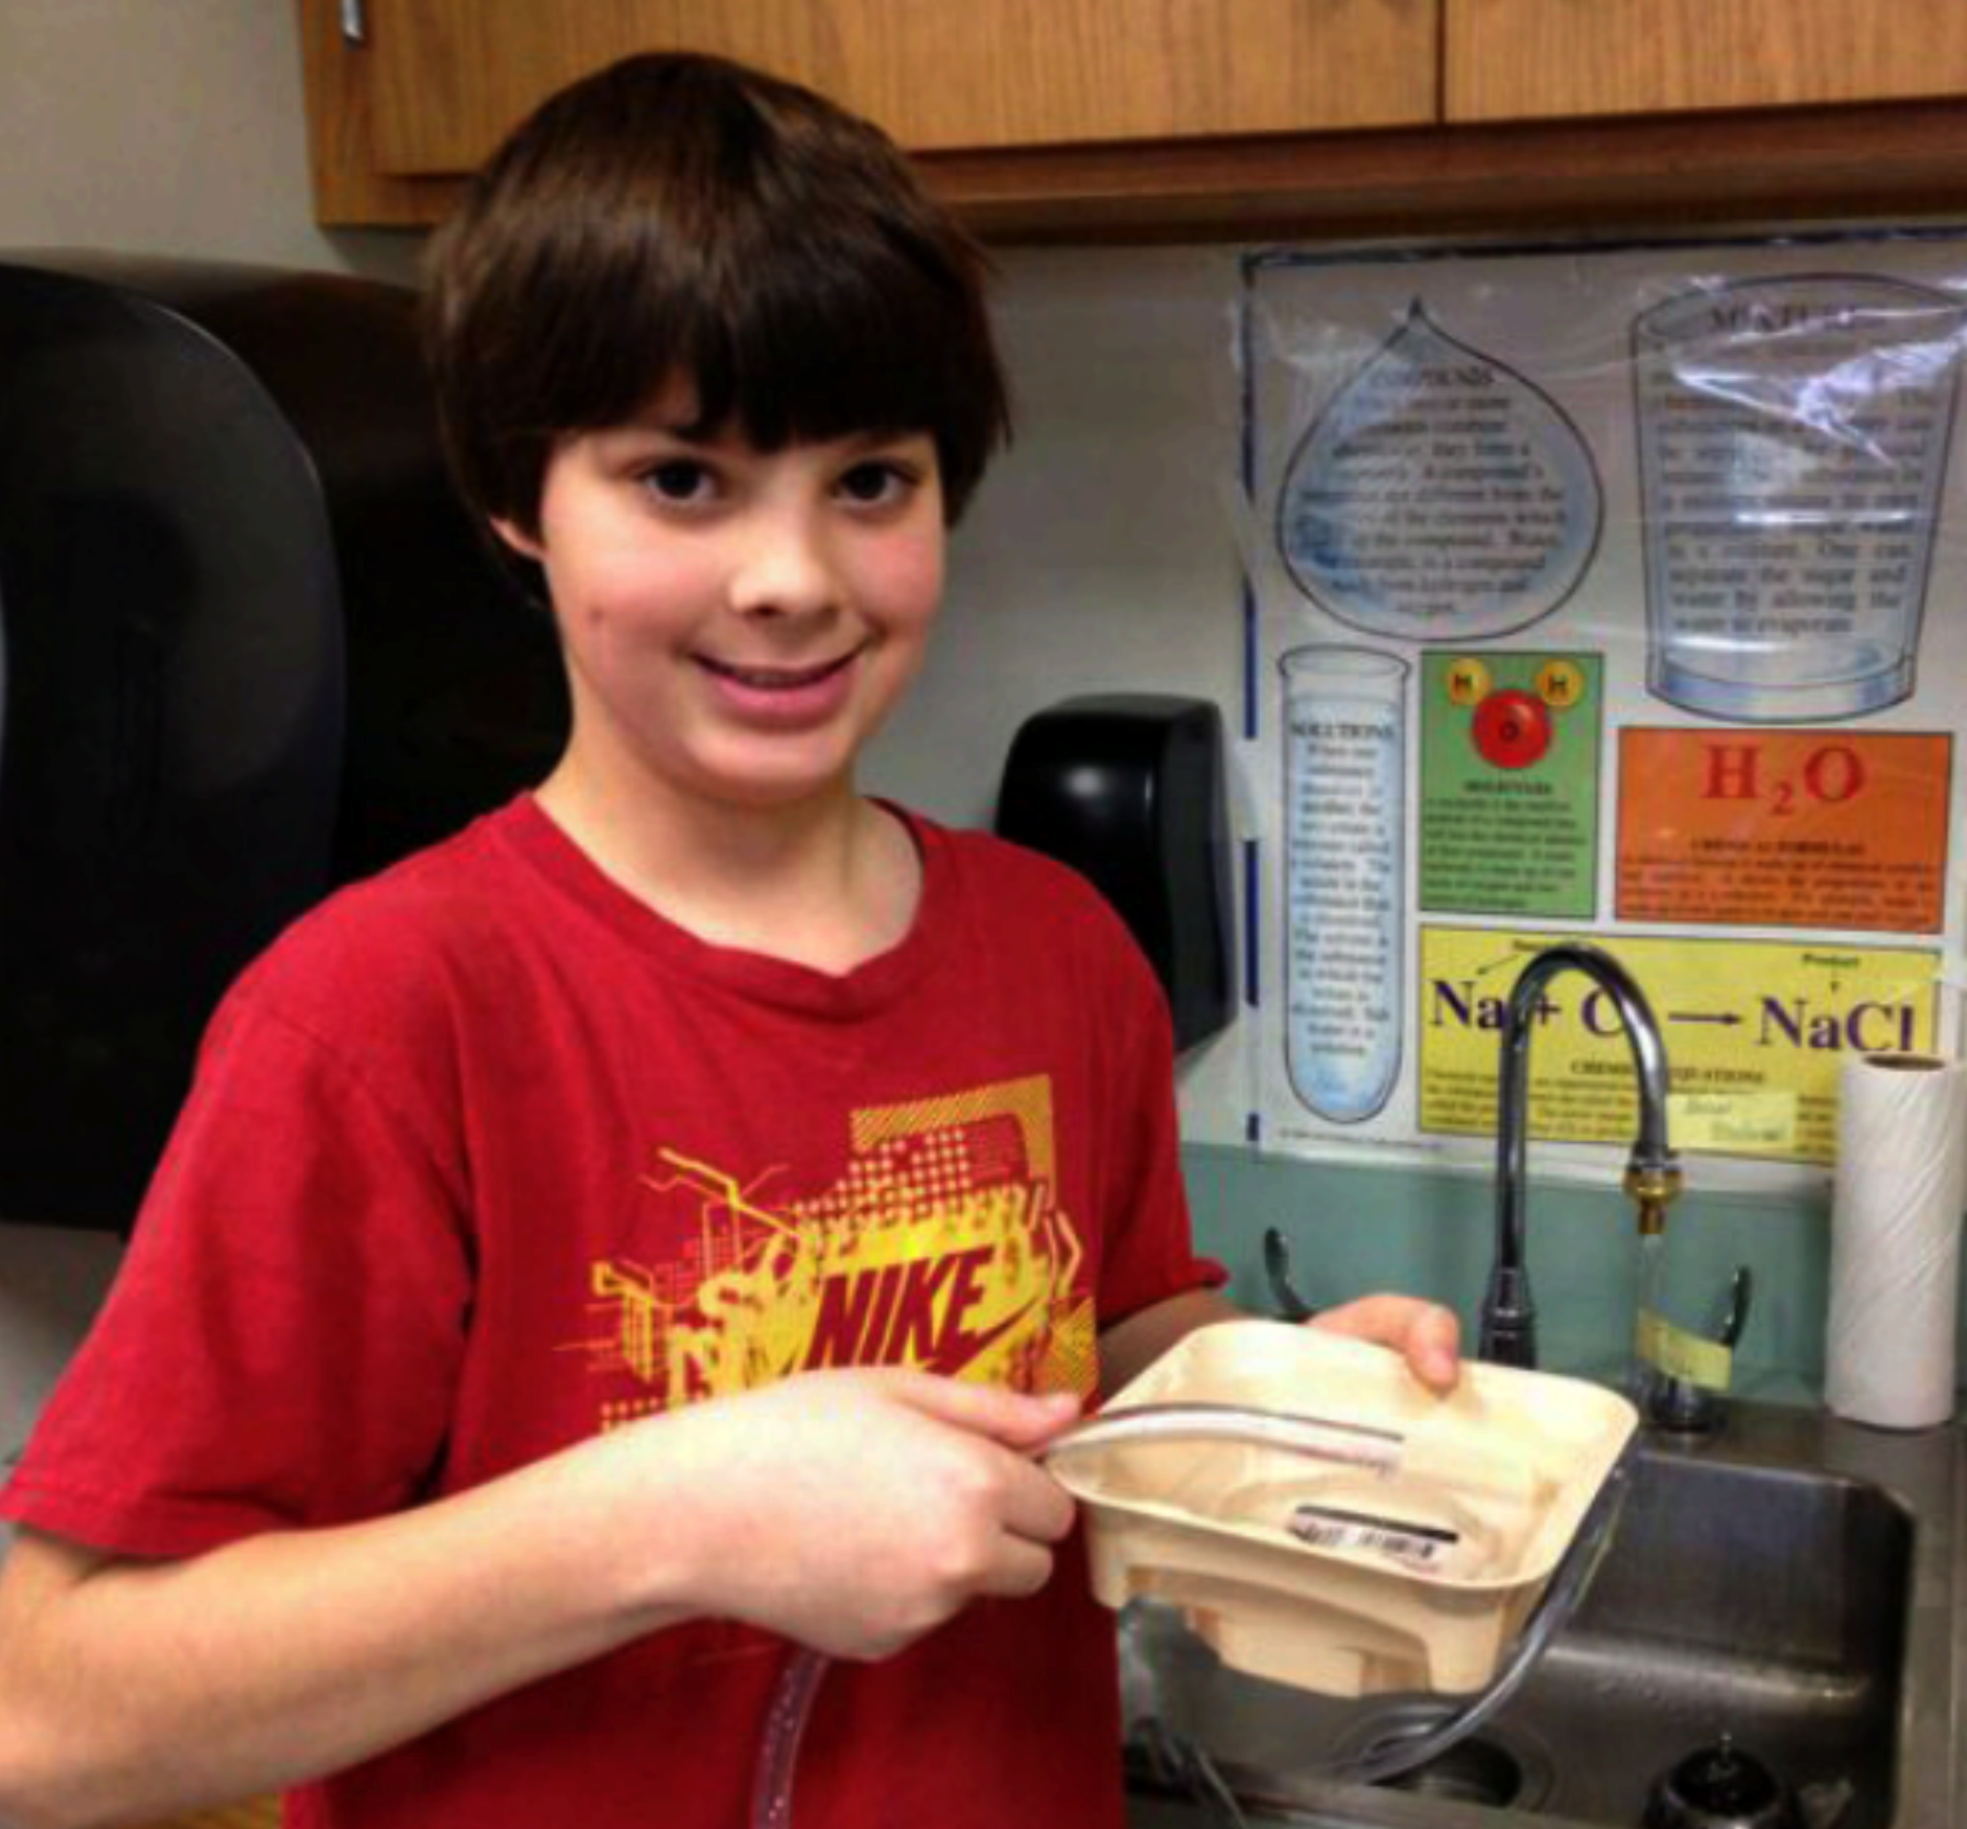
4. Build a prototype or model.
Dustin P. - New Jersey, USA
Notes:
Create It. Inventors put their idea and research into practice by building a prototype or model. Once you have an idea, you’ve got to try it! But remember, you are creating a model, not a finished product. It doesn’t need to be perfect.

Slide 8
5. Test your invention.
Alix & Alexis - Canada
Notes:
Try It! Test your invention. Inventors test their prototypes to find out if their idea will really work. Only by testing can you figure out how to make your invention better (because it’s really hard to get it right the first time.) If you can’t make an actual working model, then get feedback on your idea by showing the prototype to someone who might actually use the product.

Slide 9
6. Refine your invention.
Alisha - USA
Notes:
Tweak It. This step is where inventors improve, enhance or fix their prototypes based on what they learned through testing or feedback. It’s fun to make your good invention better!

Slide 10
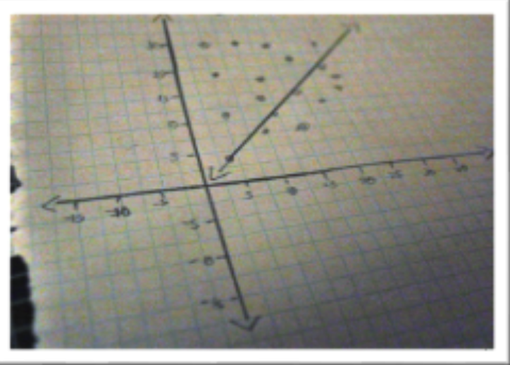
7. Market your invention.
Simpler, Faster,
Easier
No more wasting natural resources
Erica - USA
Graphboards - combines efficiency of a whiteboard with the accuracy of graph paper!
Notes:
“Sell” It. This step is when inventors market their Inventions by showing why how it’s used and why it’s better than similar products that are already available. Now’s the time to convince others to believe in your idea as much as you do.

Slide 11
The 7 Key Steps to the Inventing Process
1
2
3
4
5
6
7
Notes:
Remember, though: While these 7 steps are a great guide, there is not a single right way to approach inventing. Many inventors tell us that they repeat the try it and tweak it steps multiple times to work out all the kinks in their prototype and find a solution that can become a real product!

Slide 12
Ready to learn more?
Check out our step-by-step lessons for helpful tips on each step of the
Invention Process!
Notes:
Ready to learn more? Check out our other step-by-step lessons for helpful tips on each step of the invention process! HAPPY INVENTING!

